Slide 1
SRD-DFA Achieving Sub-Rule Distinguishing with Extended DFA Structure
Author: Gao Xia, Xiaofei Wang, Bin Liu
Publisher: IEEE DASC (International Conference on Dependable, Autonomic and Secure Computing) 2009
Presenter: Sih-An Pan
Date: 2014/08/13
Department of Computer Science and Information Engineering
National Cheng Kung University, Taiwan R.O.C.
Notes:
1

Slide 2
Introduction
To achieve high throughput, multiple regular expressions are combined and compiled into one DFA, which leads to two problems:
  State explosion of the DFA
  Sub-rule distinguishing in the combined ruleset
The combined and minimized DFA can not identify which one or multiple sub-rules are matched when the DFA arrives at some final state.

Slide 3
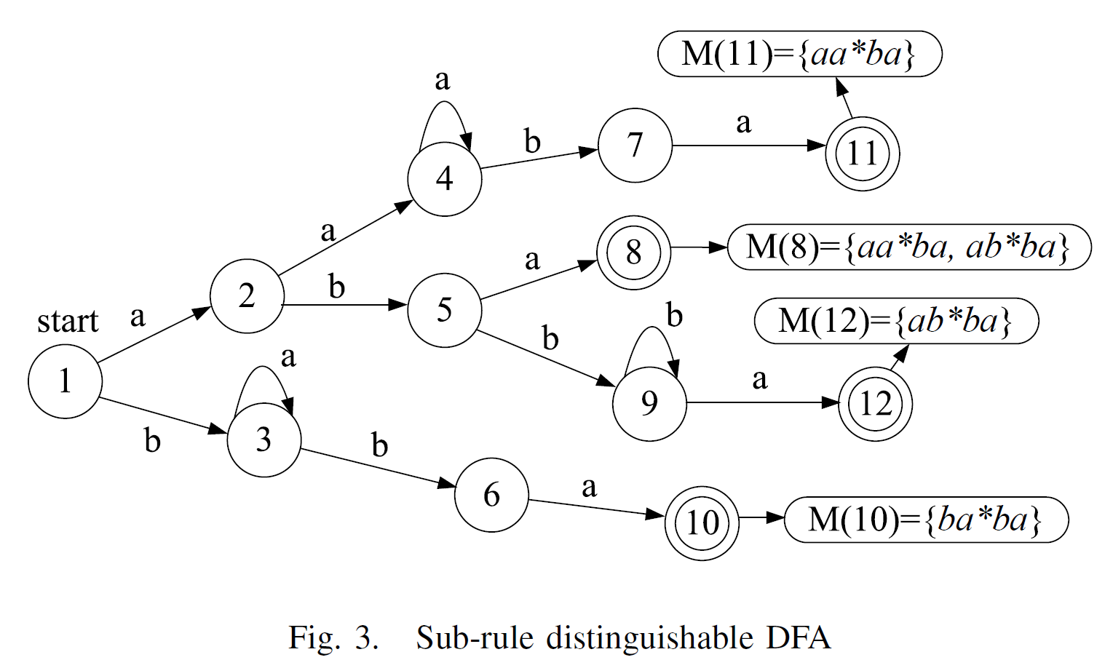
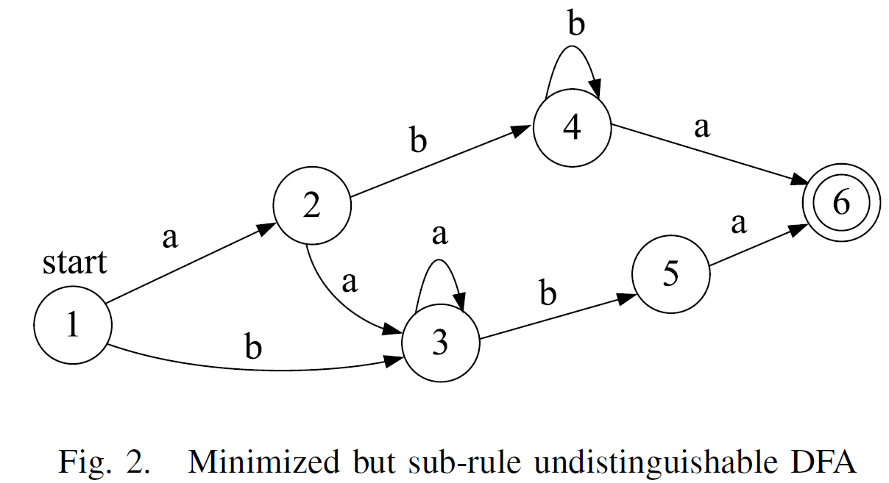
METHODOLOGY
Traditionally, these regular expressions are combined as aa*ba|ab*ba|ba*ba. Then after NFA construction, DFA generation and minimization, the final built DFA is in Fig. 2.
It is necessary to construct a DFA such as the one in Fig. 3, which is sub-rule distinguishable.

Slide 4
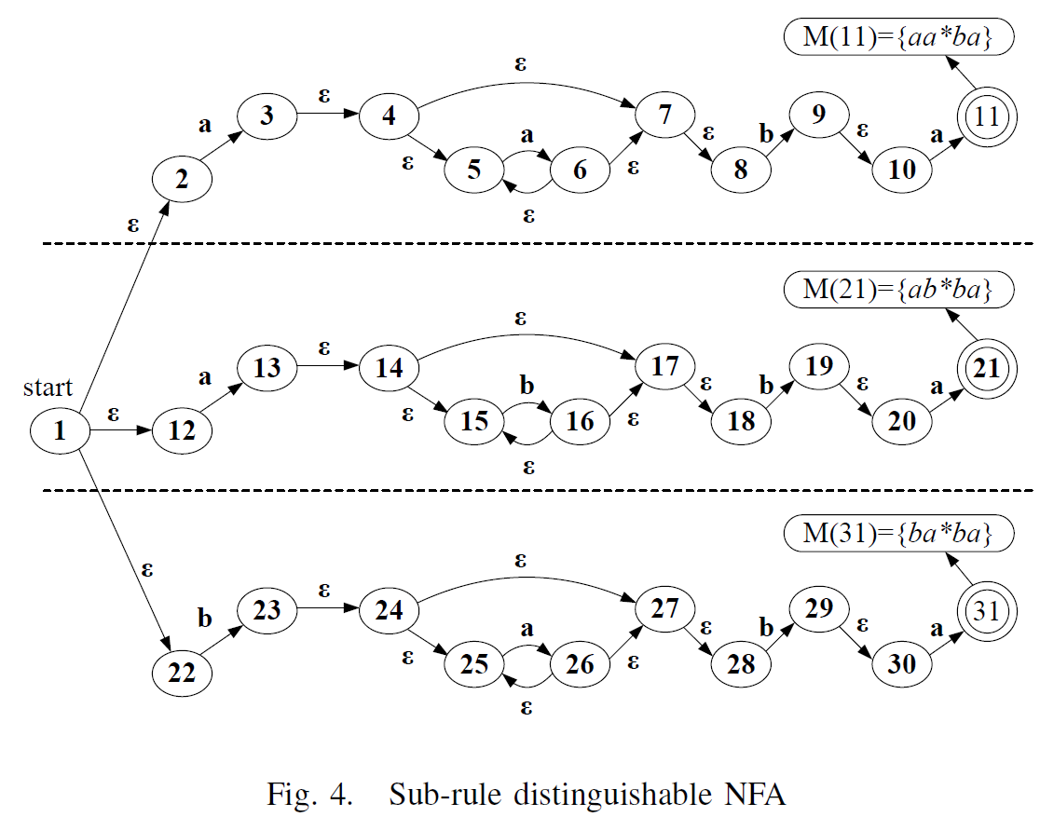
NFA Construction (Algorithm 1):

Slide 5
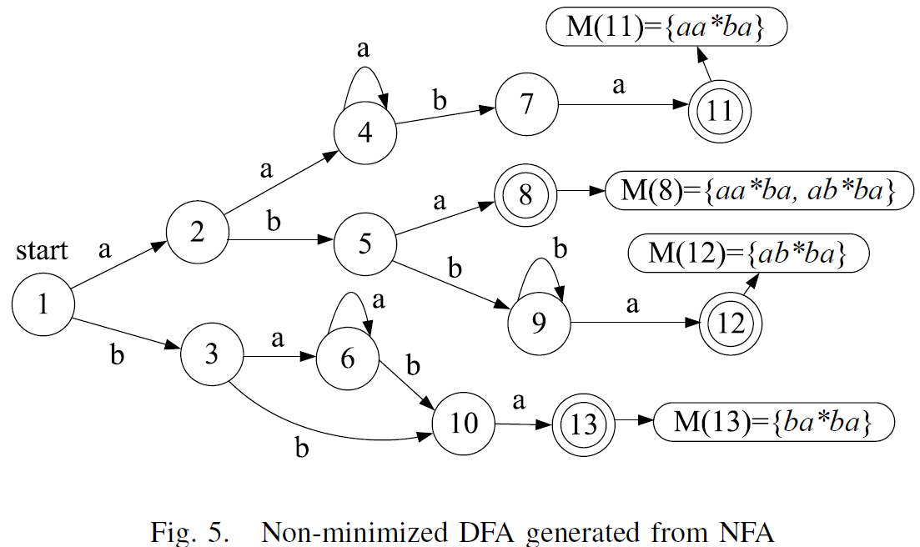
Converting NFA to DFA (Algorithm 2):

Slide 6
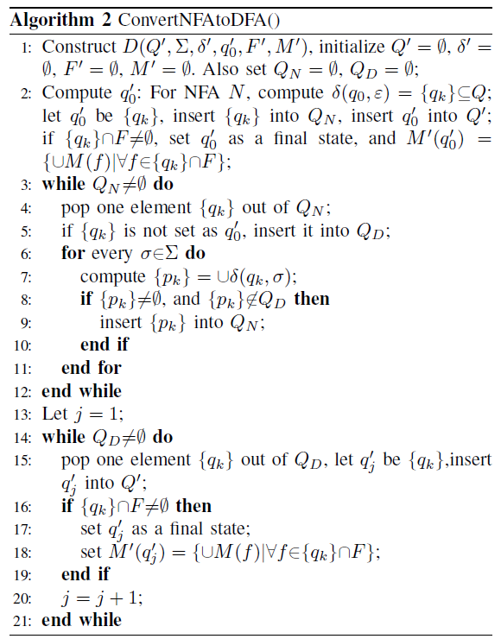

Slide 7
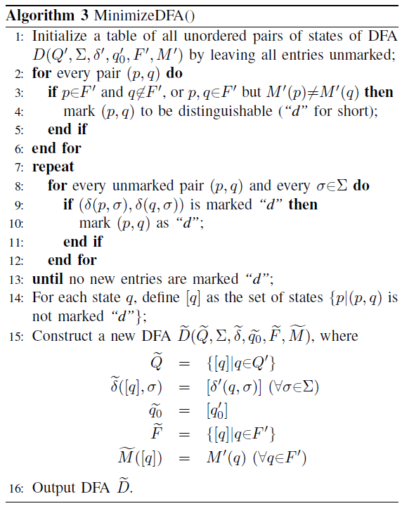
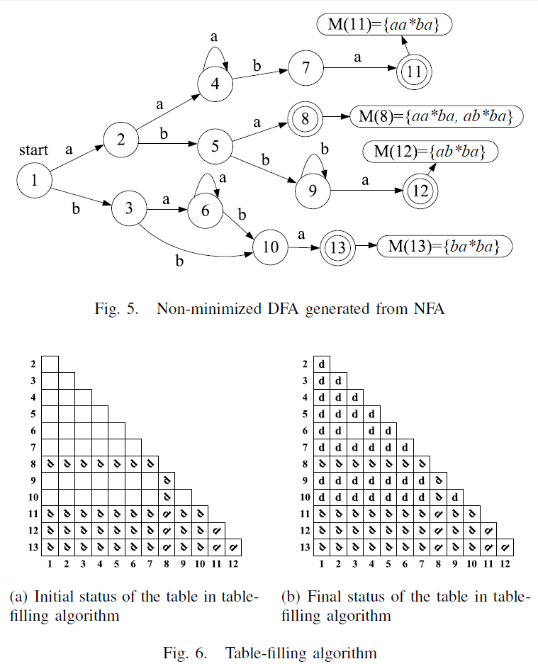
DFA Minimization (Algorithm 3):

Slide 8
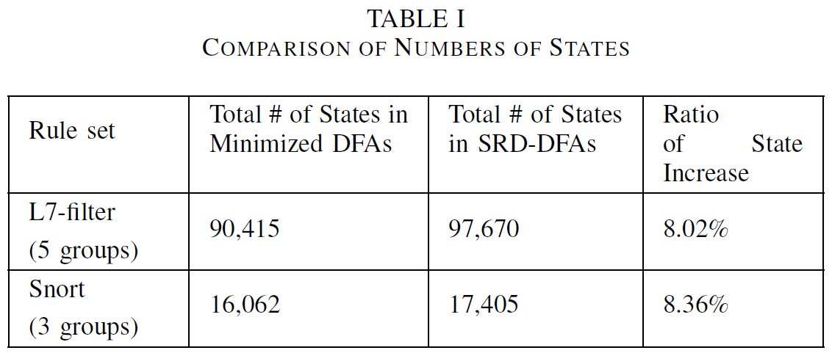
EVALUATION
Compared to the minimized DFAs, SRD-DFAs only increase the number of states by no more than 8.4%, for both the L7-filter and Snort rulesets

Slide 9
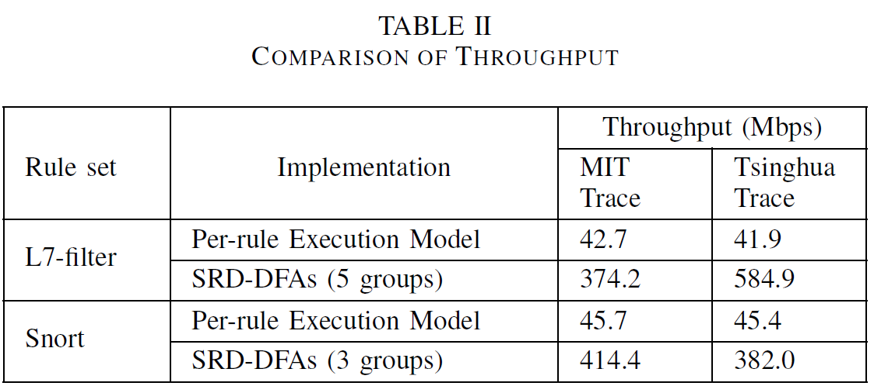
EVALUATION
Another slot of results given in Table II shows the maximal throughput with the per-rule execution implementation and our SRD-DFA based implementation.
Compared with the baseline method of sub-rules distinguishing, our method obtains 8 to 14 times higher throughput, which is significant enough for real deployment considering its limited cost.

